Slide 1
Kate Thornton-Bousfield
Head of PE and Achievement

Slide 3
YST IN ACTION: EQUIPPING EDUCATORS
Resourcing the mission
Delivering the mission
Leading the mission

Slide 4
TRANFORMING PHYSICAL EDUCATION
PARTNERSHIP WORKING

Slide 5
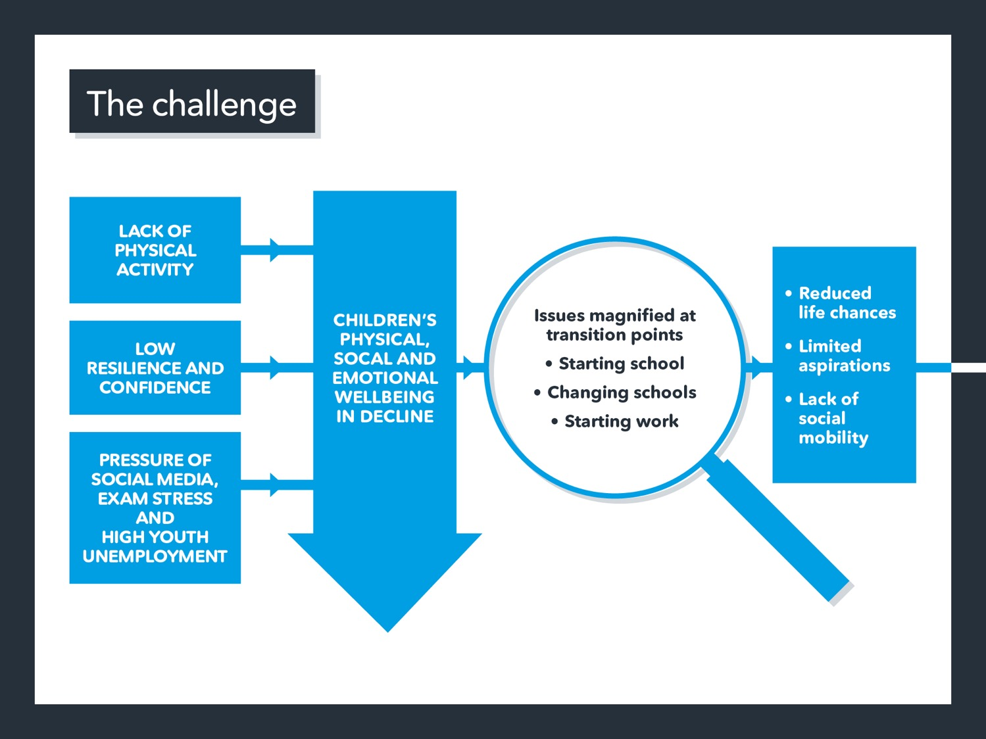

Slide 6
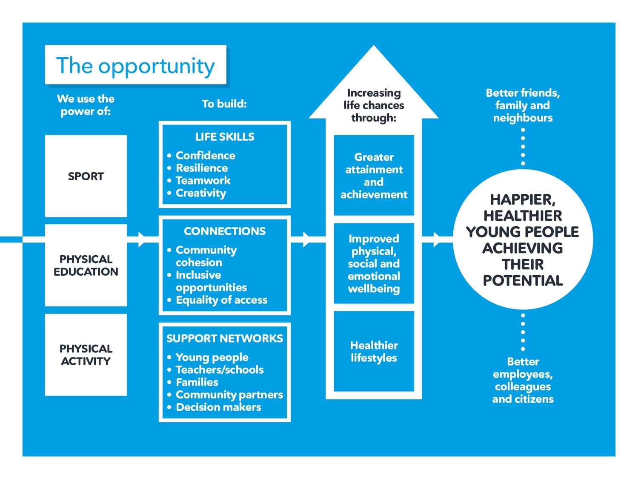

Slide 7
Why? How? What?
Notes:
Reward and recognition
Valuing PE
Raise the profile of PE, Physical Activity and School Sport
Learning in and through PE
Recognises the development of the whole child
Give purpose to pupils’ learning
Develop positive relationship with physical activity for life
Recognises and rewards the development of life skills in and through PE
Allows teachers to formally acknowledge pupils learning through evidence-based achievement
Recognises progress in physical, social, emotional and cognitive domains of learning
Purpose to pupils learning
Value PE and PA
4 stages to the award 1-4, based on developmental stage of the learner.
4 learning domains to the award
Physical, emotional, social and cognitive
Each domain assess a number of values/life skills against criteria
Journey is to experience, demonstrate, apply and value the life skills and values being taught
Learners will achieve a stage 1,2,3 or 4 Award
To achieve the award learners must meet the criteria in 4 out of 8 life skills in the emotional, social and cognitive domains.
and must meet the criteria for physical education and then choose a minimum of one other learning environment from physical activity, extra curricular, competitive sport or community.
The must choose two out of three areas to be assessed from actual competence, health fitness and well being and motivation

Slide 8
Notes:
Physical Literacy at the heart of PE

Slide 9
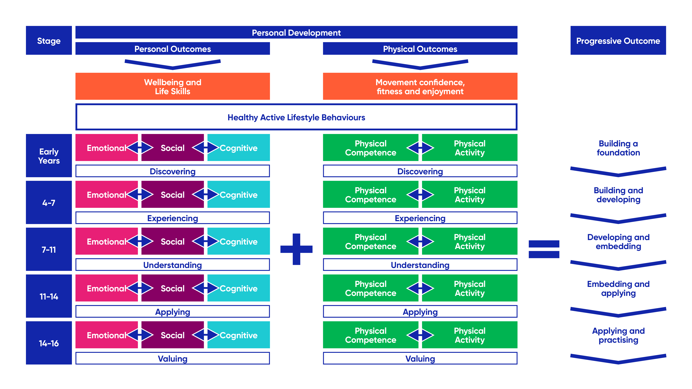
Notes:
Intent
Unpick the learner journey further by considering the YST PE curriculum blueprint.
YST curriculum blueprint
Your role is to ensure the PE curriculum is fit for purpose. The YST curriculum blueprint recognises that one size does not fit all! The blueprint reflects the key balance between the physical and personal outcomes of PE, and how each support the wider confidence, competence, health and wellbeing of pupils.
The blueprint is a stage not age approach, whereby teachers adapt the focus dependent on the needs of the learners. E.g The emphasis on the physical competency and physical activity will change. Early on the focus is very much about developing the ABC’s of movement in a fun and engaging environment, where the young people are very much learning through discovery about themselves, learning to work with others, take turns, discovering what they can do and are probably following instructions rather than making lots of decisions by themselves. At key stage 4 we are very much preparing the students to be able to make decisions about what type of activity they enjoy doing and how/when/ what they will do when they leave schools to stay active. Activities are still taught, learning still takes place. It is not recreational.
However, you may have KS3 learners who are still building a foundation, or in key stage 2 you have pupils who are at analysing and practicing level. You will decide where the focus and the related progressive outcome is relevant to your learner (e.g. flexible horizontal arrows to extend, narrow the focus on certain social, emotional, cognitive, physical elements and vertical arrow to show the progression as flexible by learner and not by age/key stage).
We very much believe this approach to physical education, with focused pedagogy that supports the journey of discovering through the valuing, will deliver the progressive outcomes on the right hand side.
Where is your focus for PE?

Slide 10
Experiencing
Understanding
Applying
Valuing
Advocating/Championing

Slide 11
Benefits
Notes:
It can be used in all education settings and has an element of personalisation to meet the needs of your learners and to complement the values of your school. The benefits of the award for teacher and pupils are many and include:
Raising the profile of PE in your school
Supporting learners to develop crucial life skills – hugely important for school and the world of work
Showing evidence of pupil progress in PE across all four domains of learning
Supporting learners physical literacy journey through experiencing, demonstrating, applying and valuing skills and values.
Engaging more pupils in PE
Helping you engage with your wider school community
Showing progress against Ofsted requirements for ‘behaviour and attitudes’ and ‘personal development’

Slide 12
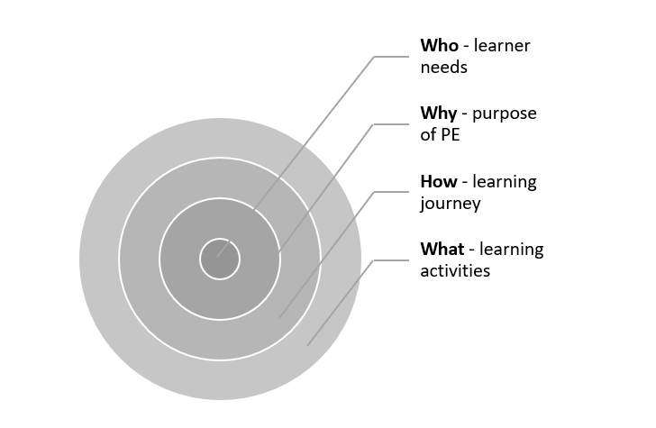
How?
Notes:
You will need to decide which year group, class or group of pupils you will begin the award with. This can be as small or as large as you like including the whole school.
It is important that a life skills approach is embedded for all pupils within your long-term plans with effective curriculum development and pedagogy before you get going.
Planning Process
Within the planning process, you may consider:
What are the needs of your learners? How do you know?
What is the purpose of your PE curriculum?
What is the starting point of your pupils and where do you aim to get them to?
Which life skills will be delivered to which learners and when?
What activities will support the life skills development?

Slide 13
How?
Approach: life skill selection
Scheme of work
Lesson structure
Cross curricular
Learning environments
Notes:
You will need to decide which life skills will be the focus. To inform this decision please consider the pupils needs, their own input, intervention group/class focus and whole school priorities and alignment with wider school.
You may have school values linked to courage and honesty and want to focus on these alongside the development of two other life skills that are pupil led.
There is no one way of doing this, no right way no wrong way. Your approach and the life skills will be personal to your school and your pupils.
Once you have decided the life skills to focus on you are ready to look at the framework to support your planning, your teaching and you assessment of the life skills.

Slide 14
Learning environments
PE
Physical Activity
Extra Curricular
School Sport
Community
Notes:
You will need to decide which life skills will be the focus. To inform this decision please consider the pupils needs, their own input, intervention group/class focus and whole school priorities and alignment with wider school.
You may have school values linked to courage and honesty and want to focus on these alongside the development of two other life skills that are pupil led.
There is no one way of doing this, no right way no wrong way. Your approach and the life skills will be personal to your school and your pupils.
Once you have decided the life skills to focus on you are ready to look at the framework to support your planning, your teaching and you assessment of the life skills.

Slide 15
Learning environments
EMOTIONAL | SOCIAL | COGNITIVE | + | PE | + | PHYSICAL ACTIVITY
4 | 4 | 4 |  | 2 |  | EXTRA CURRICULAR
 |  |  |  |  |  | SCHOOL SPORT
 |  |  |  |  |  | COMMUNITY
Notes:
You will need to decide which life skills will be the focus. To inform this decision please consider the pupils needs, their own input, intervention group/class focus and whole school priorities and alignment with wider school.
You may have school values linked to courage and honesty and want to focus on these alongside the development of two other life skills that are pupil led.
There is no one way of doing this, no right way no wrong way. Your approach and the life skills will be personal to your school and your pupils.
Once you have decided the life skills to focus on you are ready to look at the framework to support your planning, your teaching and you assessment of the life skills.

Slide 16
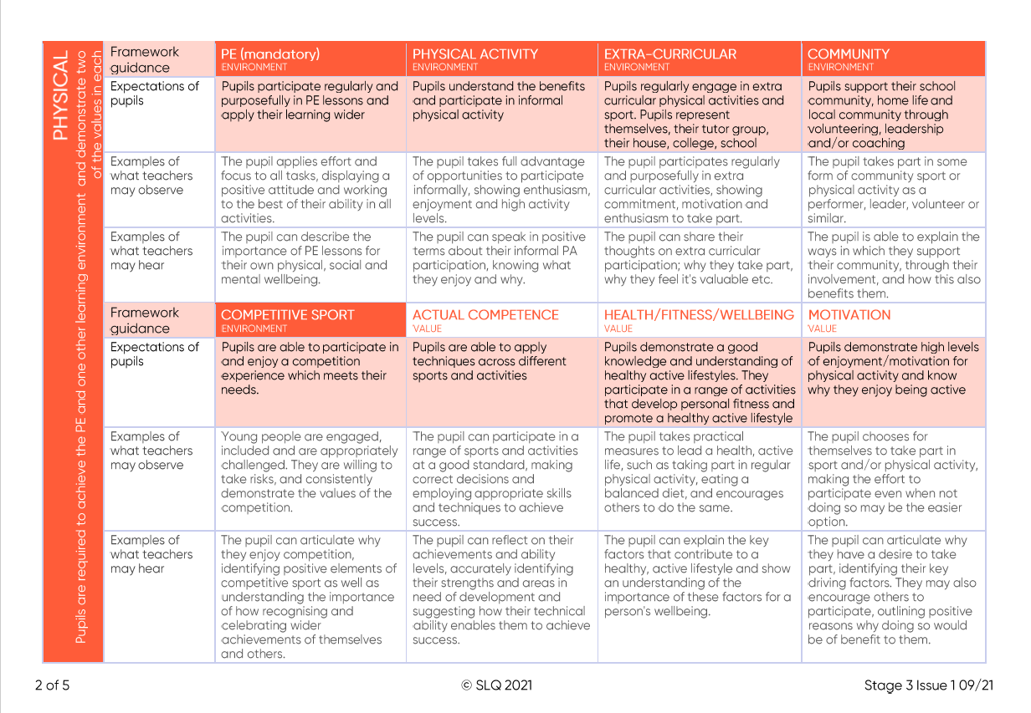
How?
Notes:
You will need to decide which life skills will be the focus. FOUR OUT OF EIGHT FOR SOCILA/EMOTIONAL AND COGNITIVE
To inform this decision please consider the pupils needs, their own input, intervention group/class focus and whole school priorities and alignment with wider school.
You may have school values linked to courage and honesty and want to focus on these alongside the development of two other life skills that are pupil led.
There is no one way of doing this, no right way no wrong way. Your approach and the life skills will be personal to your school and your pupils.
Once you have decided the life skills to focus on you are ready to look at the framework to support your planning, your teaching and you assessment of the life skills.
As a teacher, you will work with your pupils to encourage them to take opportunities to demonstrate the skills in the relevant PE Life Skills Recognition Framework. See below for an extract from the framework for Stage 2.
The PE Life Skills Recognition Frameworks are reference documents for teachers to understand what is expected of pupils in their pursuit of The PE Life Skills Award. You will track progress against this and recognise achievements that pupils make.
The targets for pupils in the PE Life Skills Recognition Framework align with the targets that are set in the pupils Learning Journal.

Slide 17
Notes:
The framework will help you and your pupils understand what is needed to be done to be successful.
Use the framework to help your lesson planning, the setting of objectives/outcomes and the success criteria.
Be explicit in your lesson objectives/outcomes ensuring language and terminology used in the lesson and in the teaching is consistent with the framework.
Plan opportunities for the life skills to be developed in and through the relevant, purposeful activities and tasks and ensure through higher order questioning pupils are aware of the life skills running throughout the lesson.

Slide 18
Notes:
Break and lunch tomes. Active travel, active classrooms,. Daily Mile type activities, D of E, Leading/coaching, self directed play and activities, PE homework activity challenges,

Slide 19
Notes:
The framework will help you and your pupils understand what is needed to be done to be successful.
Use the framework to help your lesson planning, the setting of objectives/outcomes and the success criteria.
Be explicit in your lesson objectives/outcomes ensuring language and terminology used in the lesson and in the teaching is consistent with the framework.
Plan opportunities for the life skills to be developed in and through the relevant, purposeful activities and tasks and ensure through higher order questioning pupils are aware of the life skills running throughout the lesson.

Slide 20
Notes:
The framework will help you and your pupils understand what is needed to be done to be successful.
Use the framework to help your lesson planning, the setting of objectives/outcomes and the success criteria.
Be explicit in your lesson objectives/outcomes ensuring language and terminology used in the lesson and in the teaching is consistent with the framework.
Plan opportunities for the life skills to be developed in and through the relevant, purposeful activities and tasks and ensure through higher order questioning pupils are aware of the life skills running throughout the lesson.

Slide 21
Notes:
The framework will help you and your pupils understand what is needed to be done to be successful.
Use the framework to help your lesson planning, the setting of objectives/outcomes and the success criteria.
Be explicit in your lesson objectives/outcomes ensuring language and terminology used in the lesson and in the teaching is consistent with the framework.
Plan opportunities for the life skills to be developed in and through the relevant, purposeful activities and tasks and ensure through higher order questioning pupils are aware of the life skills running throughout the lesson.

Slide 22
Notes:
The framework will help you and your pupils understand what is needed to be done to be successful.
Use the framework to help your lesson planning, the setting of objectives/outcomes and the success criteria.
Be explicit in your lesson objectives/outcomes ensuring language and terminology used in the lesson and in the teaching is consistent with the framework.
Plan opportunities for the life skills to be developed in and through the relevant, purposeful activities and tasks and ensure through higher order questioning pupils are aware of the life skills running throughout the lesson.

Slide 23
Notes:
The framework will help you and your pupils understand what is needed to be done to be successful.
Use the framework to help your lesson planning, the setting of objectives/outcomes and the success criteria.
Be explicit in your lesson objectives/outcomes ensuring language and terminology used in the lesson and in the teaching is consistent with the framework.
Plan opportunities for the life skills to be developed in and through the relevant, purposeful activities and tasks and ensure through higher order questioning pupils are aware of the life skills running throughout the lesson.

Slide 24
Notes:
The framework will help you and your pupils understand what is needed to be done to be successful.
Use the framework to help your lesson planning, the setting of objectives/outcomes and the success criteria.
Be explicit in your lesson objectives/outcomes ensuring language and terminology used in the lesson and in the teaching is consistent with the framework.
Plan opportunities for the life skills to be developed in and through the relevant, purposeful activities and tasks and ensure through higher order questioning pupils are aware of the life skills running throughout the lesson.

Slide 25
PHYSICAL
2 OUT OF 3
Physical competence/Health, fitness, wellbeing/Motivation
PE
Physical Activity
Extra Curricular
School Sport
Community

Slide 26
How?
Stages of the award
Assessment grid
Learner Journal

Slide 27
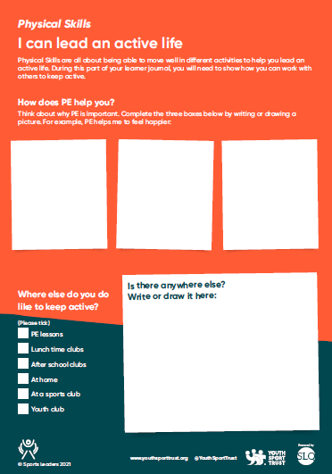
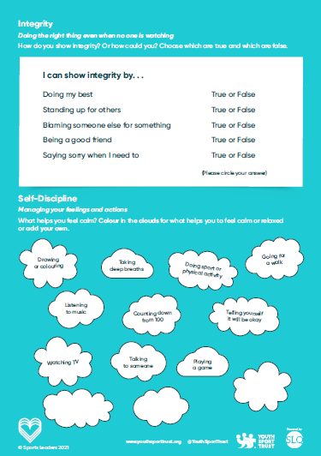
Notes:
Pupils will learn life skills within lots of different environments including:
During PE, class and at home it is important that you encourage pupils to complete their Learning Journal and give them sufficient time to reflect on the life skills they demonstrate through PE and in other areas. The Learning Journal will be used by pupils to:
Record their PE and life skills journey
Reflect on what they have learned
Demonstrate examples of experiences and behaviours that showcase a particular life skill
Gather feedback from teachers, family members and any other adults who observe the life skills in action
The Learning Journal will be used by teachers to:
Check evidence of learning and the skills in action
Inform your assessment of pupil progress
Recognise and reward pupils when they achieve a stage (experiencing, understanding, applying and valuing)
You may want to draw attention to parts of the Learning Journal at regular intervals throughout the year to focus in on a certain part of the achievements they might make.
Each pupil is unique, so it is to be expected that the learning experiences are personalised and progressive in line with individual pupils.
To achieve the Award, the minimum expectations of pupils for each of the four domains of physical literacy is outlined in the recognition framework.
The Learning Journal is a record of the pupil’s personal achievements and is theirs to keep at the end of the award.

Slide 28
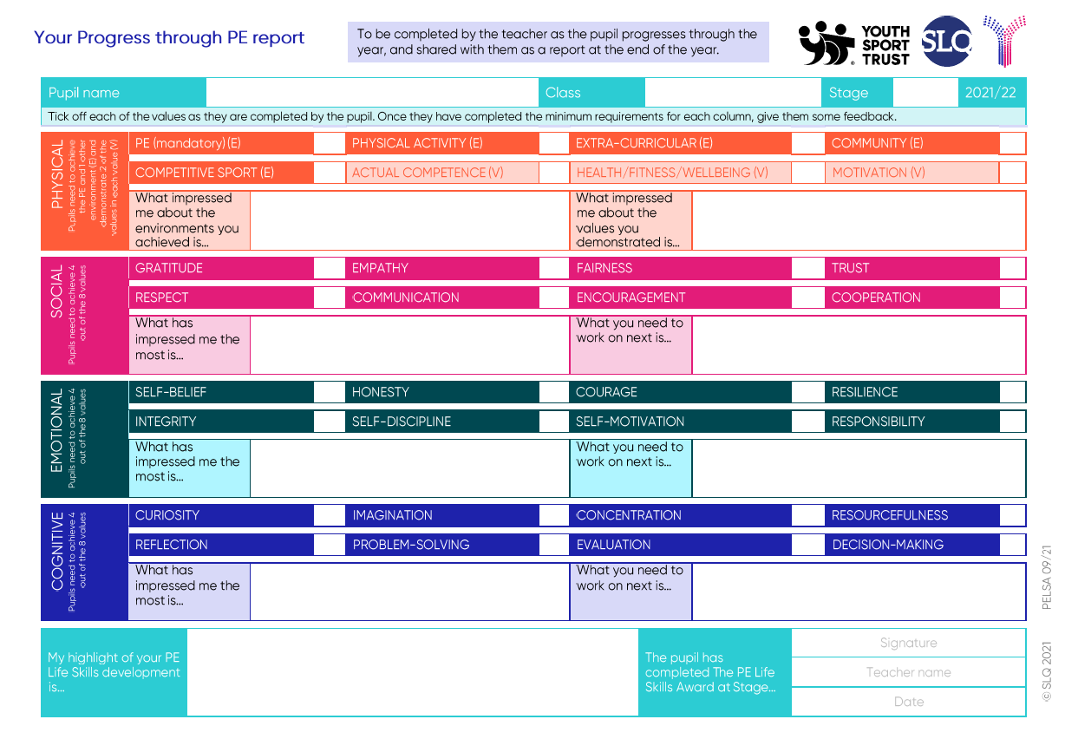
Notes:
Your role as the teacher is to track each pupil’s progress against the PE Life Skills Recognition Framework for the Stage that the pupil is at. You do this by completing the Your Progress through PE report for each pupil, that looks like this:
The Your Progress through PE report template
Through this you will recognise the achievements that pupils make, and life skills they develop, by checking off the progress they make against to the minimum expectations for each physical literacy domain (e.g. the four values required for Social Skills).
Recognition can be informed through:
Observing the pupil in PE or in other activities they take part in.
Acknowledging a pupil’s self-reflection on their skill development in the Learning Journal
Responding to comments and feedback from other people involved in the pupil’s life (e.g. parents/carers, other teachers, other pupils, and so on).
Once a pupil has completed the minimum requirements for all four physical literacy domains, you can complete the feedback sections at the bottom of the ‘Your Progress through PE’ report by highlighting a value that you are most impressed with the pupil achieving or demonstrating.
Then, sum up their overall progression by highlighting one area of the skills developed that the pupil deserves the greatest recognition for. This could be the ongoing use of a skill beyond the initial demonstration, or in helping others to achieve a skill. This is your chance to summarise what the pupil has achieved in a short statement so that the pupil can feel proud of their achievements.
Once this is completed, issue a copy to the pupil so that they can add it into their Learning Journal.

Slide 29
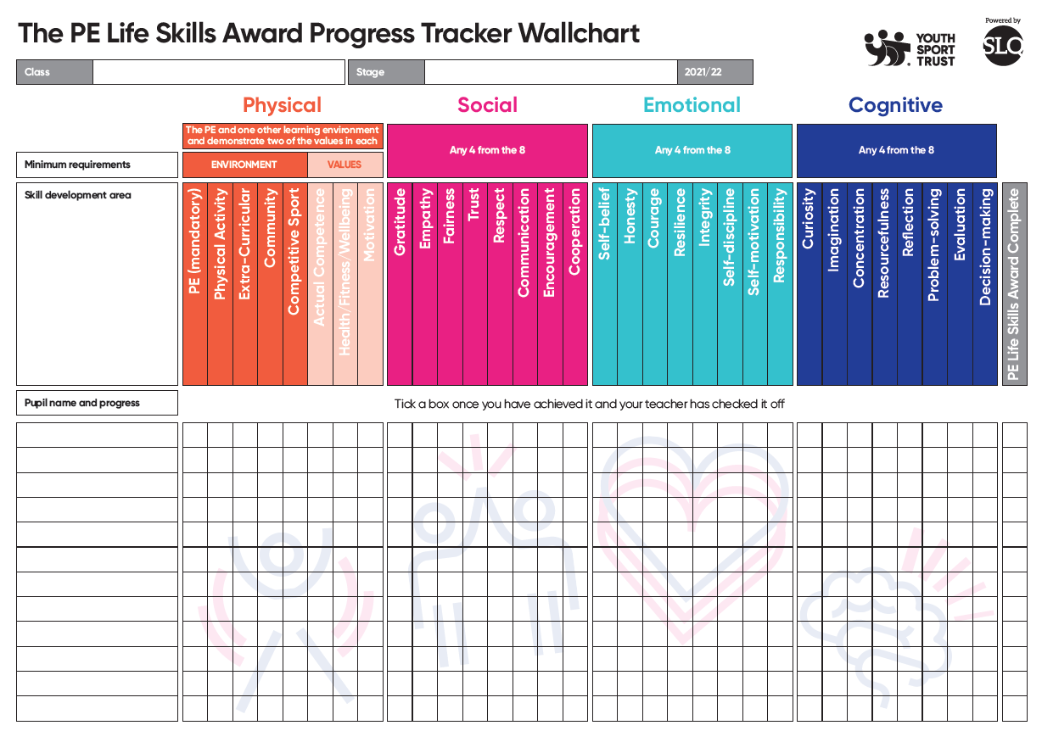
Notes:
You may also want to use one of the PE Life Skills Award wall charts to track the progress of your whole class throughout the year

Slide 30
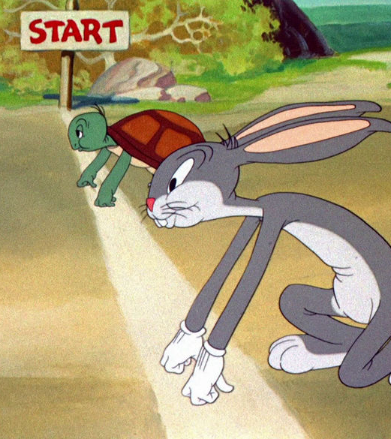
IT IS NOT A RACE
Image : BBC WORKLIFE BBC.COM
This Photo by Unknown Author is licensed under CC BY-SA
Notes:
The time spent on developing the life skills is not prescriptive, it should be in line with pupils progress.
It is crucial that enough time is given to allow pupils to develop the life skill and embed the learning.
The PE Life skills award will align with any PE scheme of work where there is a focus on life skills being developed in and through PE. You are responsible for the appropriate curriculum, teaching and learning to deliver a life skills approach, the PE award provides the progress, recognition and reward.

Slide 31
Any questions?

Slide 32
Next webinars: Next webinars; Tuesday 8 February – Well Schools and follow up to the PE Life Skills Award introductory webinar 18 / 19 June – A ‘school sport’ focused webinar during National School Sports Week that will explore sport enrichment.

