Slide 1
Sexual and Gender-Based Violence

Slide 2
Plan for today
Survey #1
What is sexual and gender-based violence?
Sexual and gender-based violence in schools
The prevalence and underreporting of sexual and gender-based violence
Masculinities and sexual and gender-based violence
Digital sexual violence
Survey #2
Notes:
Lay down the ground rules and make sure everyone is onboard and feels comfortable.
No personal comments
How we work: 100% unembarrassable; we ask that you are respectful of one another today; no obligation to participate - nip to the loo if you need to at any point; we are not making judgements about your lives/what might be relevant - we appreciate some info today will not be relevant to you now or ever, and some information may be new to some people but not to others; but hopefully there will be something for everyone today. As per your usual lessons the sessions will be confidential unless we had a safeguarding concern in which case we would just pass that onto the person that needs to know.

Slide 3
Survey
Before we start the workshop, we would like to find out what you already know.
Please fill out the quick survey, and include your initials.
Notes:
Ask students to fill out a quick survey so we can find out what they already know. Please ensure they only provide their initials, not their name, and that they complete all the answers.
Link to survey: https://docs.google.com/document/d/16KKAN0Jc3ZKrtKbtWnfBFf5boBnrEm0V/edit

Slide 4
What is Sexual and Gender-Based Violence?
Any act or activity of a sexual nature which is unwanted and takes place without consent.
Sexual and gender-based violence is about power and control (removing capacity and freedom) not sex or love.
Notes:
‘“Sexual violence” is a term ... to describe any sexual activity or act that happened without consent, ... that was unwanted or involved one or more of the following: pressure, manipulation, bullying, intimidation, threats, deception, force’ (Rape Crisis England & Wales).
The term ‘sexual violence’ is an all-encompassing term that refers to a range of acts, some of which are criminal offences, like sexual assault, rape, and sexual abuse (RAINN).
Some acts aren’t as yet legally defined as crimes, e.g., street harassment, but they are still harmful. And thanks to the campaigning efforts of young women and girls in recent years, more acts are now criminal offences, e.g., an upskirting law came into force in 2019 after the campaigning efforts of Gina Martin (and others), and street harassment is likely to be criminalised by the Government soon.
Important: All forms of sexual and gender-based violence involve the exercise of power and control, denying victims/survivors freedom and the capacity to give consent. Sexual violence is not about sex or love.

Slide 5
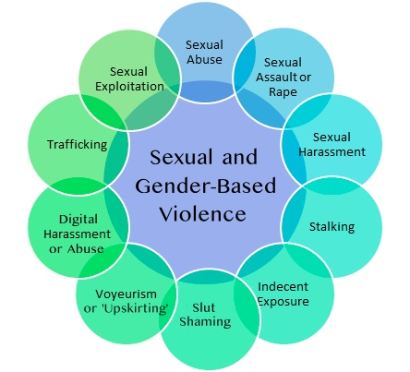
Notes:
What we see here is that sexual and gender-based violence happens in many ways and spaces and that the different categories overlap.
Important to note:
Make sure to reiterate that sexual and gender-based violence is not only physical violence - it includes emotional, interpersonal, verbal, digital sexual violence etc. - e.g. sexual comments, leering, following, upskirting, slut-shaming, sharing nudes, etc.
These are only examples, and they do not cover the range of types and experiences of sexual and gender-based violence.
There is no hierarchy between these examples and they cannot be ranked according to perceived harm. ALL forms of sexual and gender-based violence are capable of causing harm and are unique to the individual’s experience.
The Internet (i.e. social media platforms) is just a new vehicle for facilitating existing trends of sexual and gender-based violence. For example, unsolicited dick pics (also known as ‘cyberflashing’) are the online version of in-person ‘flashing’ or indecent exposure. (While cyber or digital harassment) is listed as a distinct category, it can facilitate most of these examples (aside from sexual assault and rape that involves physical touch).

Slide 6
Key points
These are only examples: they do not cover the range of types and experiences of sexual and gender-based violence.
Violence is not only physical violence - it can include emotional, interpersonal, e.g., sexual comments and slut-shaming
Although in legal terms hierarchies exist between these examples, i.e., some practices are illegal and others are not, in terms of how they are experienced by victim-survivors, there is no hierarchy between these examples. ALL forms of sexual and gender-based violence are capable of causing harm and are unique to the individual’s experience.
All of these examples can take place online too (except those that involve physical touch).
Online spaces can facilitate existing trends of sexual and gender-based violence.
Notes:
Important to note:
These are only examples, and they do not cover the range of types and experiences of sexual and gender-based violence.
Sexual and gender-based violence is not only physical violence - it includes emotional, interpersonal, verbal, digital sexual violence etc. - e.g. sexual comments, leering, following, upskirting, slut-shaming, sharing nudes, etc.
Although in legal terms hierarchies exist between these examples, i.e., some practices are illegal and others are not, in terms of how they are experienced by victim-survivors, there is no hierarchy between these examples and they cannot be ranked according to perceived harm. ALL forms of sexual and gender-based violence are capable of causing harm and are unique to the individual’s experience.
All of these examples can take place online too (except those that involve physical touch).
The Internet (i.e. social media platforms) is just a new vehicle for facilitating existing trends of sexual and gender-based violence. For example, unsolicited dick pics (also known as ‘cyberflashing’) are the online version of in-person ‘flashing’.
Examples of online sexual violence will also change in the future as well. So there might be trends developing right now that we currently don’t recognise as harmful that will one day be classified as such.

Slide 7
Sexual and Gender-Based Violence in Schools
Considering the wide range of acts and activities that count as sexual and gender-based violence:
Do you think that sexual and gender-based violence happens in schools?
Discuss for two minutes. Write down examples on post-it-notes.
Notes:
Ask students to write down examples on post-it notes in their smaller groups and then display the post-its on the wall, grouped in themes.
Feedback from students. Remind them about the ‘no personal comments’ ground rule. Be prepared for the disclosures.
Discussion notes:
Link to Everyone’s Invited
Get feedback from students
Ask: Is sexual and gender-based violence common in school? Do people who enact it get in trouble? What about the people who are victims/survivors - how are they seen? Do they report their experiences?
If any of the perpetrators go unpunished, if victims are blamed, if these behaviours are normalised …

Slide 8
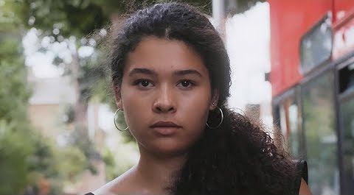
These are examples of rape culture - a culture in which sexual and gender-based violence is treated as the norm and victims/survivors are blamed for their own assaults.
Notes:
These are examples of rape culture - a culture in which sexual and gender-based violence is treated as the norm and victims/survivors are blamed for their own assaults.
Video: Plan International UK: Street Harassment #ISayIt’sNotOkay
Link: https://www.youtube.com/watch?v=sdn15-t7kg0&t=3s
As this video shows, experiencing some forms of sexual and gender-based violence is so commonplace for girls, that it can feel like ‘a normal part of growing up’.

Slide 9
Let’s discuss
What four forms of sexual and gender-based violence did you identify in the video?
What role did gender play in the video?
What else did you notice about their identities?
Think about how the girls in the video might feel.
Notes:
4 forms of sexual and gender-based violence in the video:
1. street harassment (leering, winking, catcalling, unwanted comments),
2. ‘groping’/sexual assault,
3. upskirting,
4. ‘slut shaming’
Identities: if students are struggling with this question, ask about age, ethnicity and religion.
How might the girls in the video feel? Emphasise that they are likely to experience a range of emotions e.g., embarrassment, annoyance, anger and fear. The girls are likely to be both frustrated and confused that they’re often sexually harassed and sexually objectified by men and boys and then ‘slut shamed’ by their parents (by telling them not to wear certain clothes). Is this fair? Is this another example of rape culture?

Slide 10
The Prevalence of Sexual and
Gender-Based Violence in the UK
Nearly 90% of girls and nearly 50% of boys have often or sometimes been sent unwanted explicit images or videos (or their peers were) (Ofsted, 2021)
22.9% of women
& 4.4% of men
have survived sexual assault or attempted sexual assault
45%
of gay and
bisexual men
in Britain have been sexually assaulted
97%
of young women
aged 18-24
have been sexually harassed
Office for National Statistics (ONS), 2021
SurvivorsUK, 2021
YouGov poll for UN Women, 2021
Notes:
Sexual and gender-based violence can happen to anyone, no matter their gender, ethnicity, age, sexual orientation, or gender identity
Anyone can be a perpetrator of sexual and gender-based violence.
Nonetheless there are patterns. The evidence shows that women and girls (and LGBTQ people) are often the victim-survivors and men are usually the perpetrators. For example, 98% of people who had survived rape or serious sexual assault reported that the perpetrator(s) were male (Office for National Statistics, 2021).
These stats however only reflect reported or estimated incidents of sexual and gender-based violence. We know that SGBV is underreported by survivors of all genders, ethnicities, ages and sexual and gender identities.

Slide 11
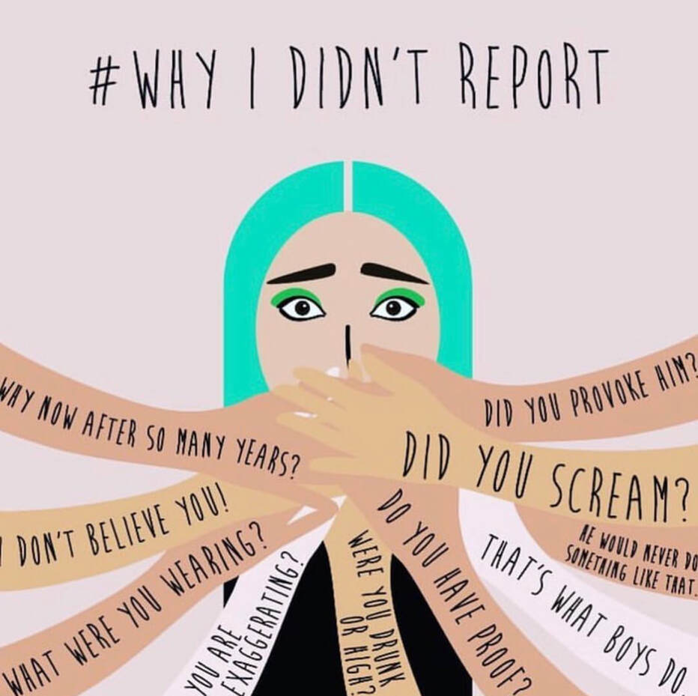
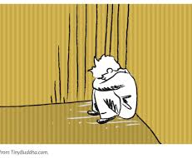
Underreporting of Sexual & Gender-Based Violence
Only 5% of young people told their parents/carers about their experiences of image-based sexual harassment & abuse, and a mere 2% reported it to their school (Ringrose, Regehr and Milne, 2021).
37% of gay and bisexual men felt they could not speak to anyone after experiencing sexual assault and only 14% reported their experience to the police (SurvivorsUK, 2021).
Why do you think some people struggle to report sexual and gender-based violence?
Notes:
It is impossible to accurately gauge the percentage of sexual and gender-based violence that is not reported and there can be several reasons that serve as a barrier between the victim-survivor and possible sources of help and support, including:
the relationship between the survivor and the perpetrator,
feelings of embarrassment, shame, or self-blame, e.g., societal myths and victim-blaming attitudes prevalent in society significantly contribute to the stigma surrounding sexual and gender-based violence and act as a barrier to reporting
the fear of retaliation, including physical abuse
not wanting their family to know or worrying they won’t be believed,
and some survivors simply downplay or minimise the experience.
Survivors may also not disclose due to a fear/distrust of the criminal justice system, e.g., believing that the police will not help. Often this is linked to structural inequalities which make it harder for some groups to report because of systemic prejudices that leave them not trusting authorities or the police. Similarly students might not report their experiences of sexual and gender-based violence to teachers as they worry their school will not deal with the issue effectively, either by not doing anything or by overreacting.
For many male survivors, stereotypes about masculinity can also make it hard to disclose to friends, family, or the community. On average, it takes a man 26 years before they tell someone about their experience. Men and boys also may face challenges believing that it is not possible for them to be victims of sexual and gender-based violence, especially if it is perpetrated by a woman. Some men who have survived sexual assault as adults feel shame or self-doubt, believing that they should have been “strong enough” to fight off the perpetrator.

Slide 12
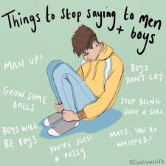
Masculinities and Sexual and Gender-Based Violence
The Idea that being a ‘man’ = strong, dominant, sexually assertive
Leads to...
Some boys and men participating in sexual and gender-based violence, and rape culture
Some boys and men underreporting sexual and gender-based violence
Societal ideals of masculinity negatively impact everyone - including boys and men.
Notes:
Survivors may also not disclose due to a fear/distrust of the criminal justice system, e.g., believing that the police will not help. Similarly students might not report their experiences of sexual and gender-based violence to teachers as they worry their school will not deal with the issue effectively, either by not doing anything or by overreacting.
For many male survivors, stereotypes about masculinity can also make it hard to disclose to friends, family, or the community. On average, it takes a man 26 years before they tell someone about their experience. Men and boys also may face challenges believing that it is not possible for them to be victims of sexual and gender-based violence, especially if it is perpetrated by a woman. Some men who have survived sexual assault as adults feel shame or self-doubt, believing that they should have been “strong enough” to fight off the perpetrator.

Slide 13
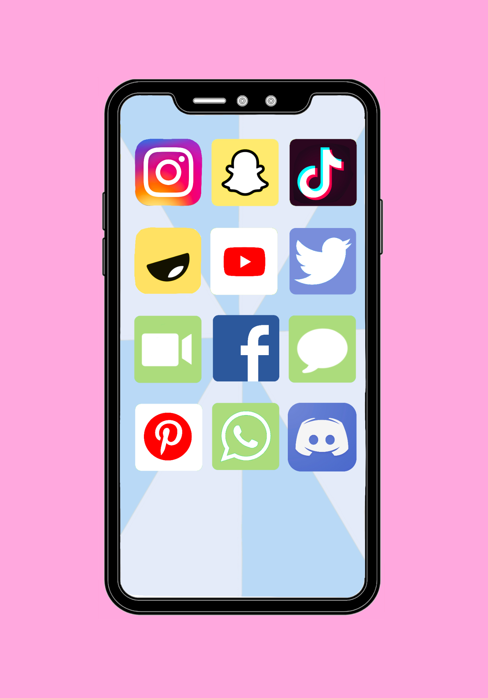
Digital Sexual Violence
A range of acts and activities where digital technologies are used to enable sexually based harms on and offline.
There are 3 types of digital sexual violence.
Notes:
Digital sexual violence refers to a range of acts and activities where digital technologies are used to facilitate both virtual and face-to-face sexually based harms.
There are 3 types of digital sexual violence.

Slide 14
Unsolicited Sexual Images
Any sexual content shared online which is not wanted by the recipient is image-based sexual harassment.
This can include:
unsolicited dick pics, ‘cyberflashing’, pornographic images from bots, unwanted nude images/videos.
Notes:
Unsolicited Sexual Images
Any sexual content shared online which is not wanted by the recipient is image-based sexual harassment.
This can include: unsolicited dick pics, ‘cyberflashing’, pornographic images from bots, unwanted nude images/videos.

Slide 15
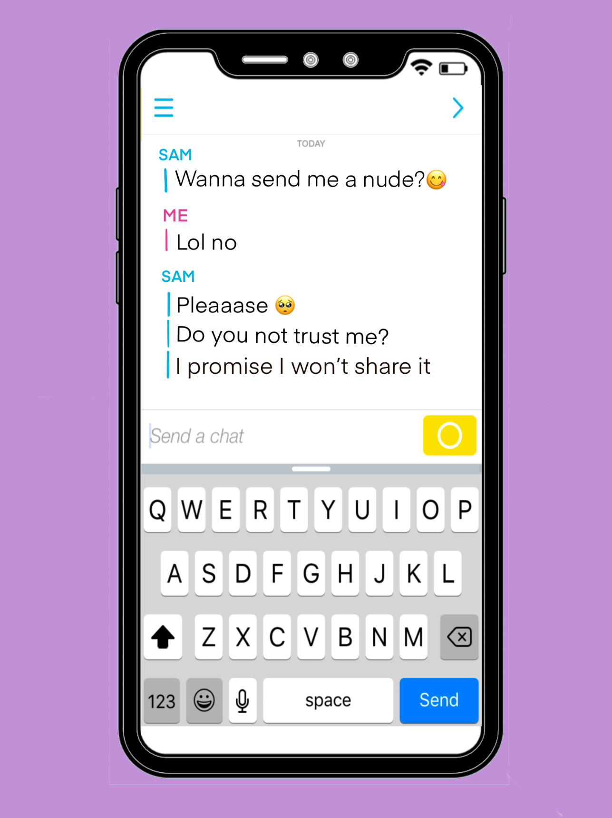
Digital Sexual Pressure & Coercion
Being pressured or forced to engage in sexual activity on or offline via digital technologies is also image-based sexual harassment.
This can include: pressurising, blackmailing or bribing someone to send nudes.
Notes:
2. Digital Sexual Pressure & Coercion
Being pressured or forced to engage in sexual activity on or offline via digital technologies is also image-based sexual harassment.
This can include: pressurising, blackmailing or bribing someone to send nudes.

Slide 16
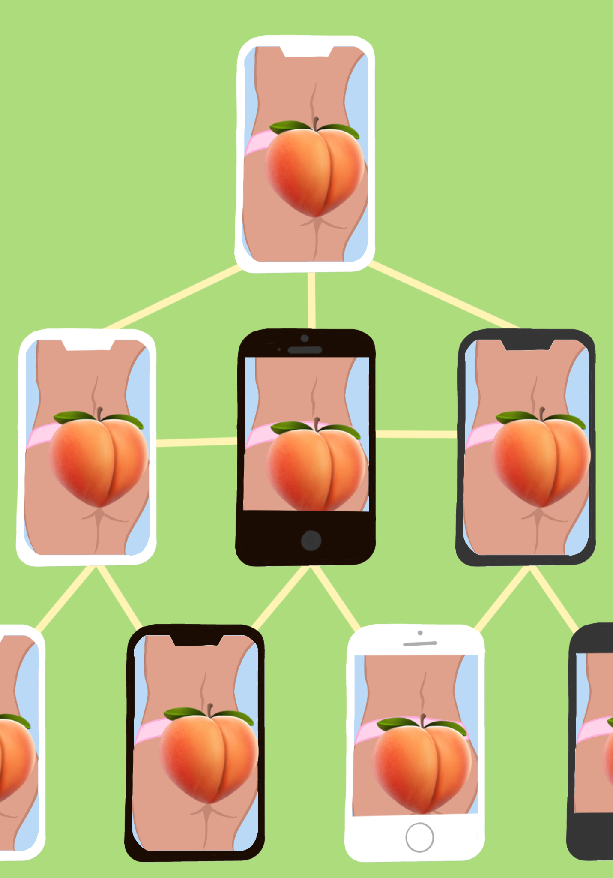
Non-consensual Taking or Sharing of Nudes
Creating, sharing or threatening to share someone’s nudes without their consent is image-based sexual abuse (sometimes called ‘revenge porn’).
Can include: forwarding a nude in a group chat, showing a nude of someone else on a phone, upskirting.
Notes:
3. Non-consensual Taking or Sharing of Nudes
Creating, sharing or threatening to share someone’s nudes without their consent is image-based sexual abuse (sometimes called ‘revenge porn’).
Can include: forwarding a nude in a group chat, showing a nude of someone else on a phone, upskirting.

Slide 17
Scenario 1
Does it count as sexual and gender-based violence? Why?
What is wrong with the teacher’s response? How could it be improved?
Adrian grabs Laura’s bum. Laura reports it to the teacher, who says ‘I saw you flirting with him last week.’
Notes:
Divide class into groups of six and get them to explore and discuss one scenario each for 2-5 minutes (max).
Ask each group to report back to the class - maybe ask for two people from each group to act as spokespeople to ensure engagement.
If there is insufficient time to discuss all six scenarios, ensure that a range of scenarios are discussed, e.g., offline and digital sexual violence and a scenario where a boy is a victim of SV, e.g., scenarios 1, 2 and 4 (or 6).

Slide 18
Scenario 2
Does it count as sexual and gender-based violence? Why?
How is Sophie’s gender relevant in this scenario?
Sophie is snapping a boy she really likes. All of a sudden he sends a photo of his penis with the caption ‘you turn me on.’

Slide 19
Scenario 3
Does it count as sexual harassment? Why?
How is Liam’s gender relevant in this scenario?
Nifa messages Liam. She really likes him and hopes their friendship can develop into a relationship. Liam asks for nudes. She isn’t sure, so avoids the subject. Liam keeps asking, saying it would prove she likes him.

Slide 20
Scenario 4
Does this count as image-based sexual abuse? Why?
What role does consent play in this scenario?
Sasha and Jacob are dating and consensually share intimate photos. They split up and Sasha shares a dick pic of Jacob with her friends, joking ‘he wasn’t worth it anyway!’

Slide 21
Scenario 5
Does this count as image-based sexual abuse? Why?
What role does sexual orientation play in this scenario?
Nathan’s friends are sharing nudes of girls in a group chat. He feels uncomfortable with this, but doesn’t speak up because he is afraid they’ll call him ‘gay’.

Slide 22
Scenario 6
Does this count as sexuality-based harassment? Why?
How could Charlie’s friends respond?
Charlie confides in Alex that he is bisexual. After an argument, Alex exposes his sexual orientation on social media.

Slide 23
Online reporting - 3 useful tools:
Internet Watch Foundation
Removes sexual images of children from the internet. You can report anonymously & it’s easy to use.
Note: can’t remove images from personal devices. May not work for private sharing e.g. Whatsapp/Snapchat.
CEOP
Can be used to report online abuse or grooming online.
Leave your contact details and one of their Child Protection Advisors will get in touch to make sure you get the help you need.
Very easy to use.
Report Harmful Content
Can be used to report:
Threats
Unwanted sexual advances
Harassment
Bullying.
They’ll help you to ensure you’ve reported to the app before you report to them. Easy to use.
Find time to look up the sites above so you know how they work if you ever need them.
Revenge Porn Helpline is for over 18s to report image based sexual abuse.
Notes:
CEOP = Child Exploitation and Online Protection Command
This slide will be provided as a handout

Slide 24
Some places you can go to talk things through
Rape Crisis - support for girls aged 13+ who have survived ANY type of sexual & gender-based violence (including online): rapecrisis.org.uk
Galop - support for LGBTQ+ people surviving abuse aged 13+: galop.org.uk
Imkaan - specialist BAME ending violence against women & girls agencies: imkaan.org.uk/get-help
Childline - support for U18s on any issue: childline.org.uk
Stop Street Harassment - help, advice and resources for tackling street harassment: stopstreetharassment.org
Remember you can also:
Block and report harmful/unwanted content
Survivors UK - support for men, boys and non-binary survivors of sexual & gender-based violence aged 13+: survivorsuk.org
Respond - support for survivors of sexual & gender-based violence with a learning disability aged 13 +: respond.org.uk
The Mix - support for U25s on any issue: themix.org.uk
Everyone’s Invited - a safe space for survivors of sexual & gender-based violence to share their story: everyonesinvited.uk
Everyday Sexism Project - a space to share stories of sexual harassment, abuse & other forms of everyday sexism: everydaysexism.com
Talk to parents, friends and trusted adults.
Notes:
This slide will be provided as a handout.
Explain that someone might also want to report to the police (they don’t have to if they don’t want to) - and they can get extra support with this from the first four organisations on this list with either deciding whether they want to report or not, or help navigating the criminal justice system.
For some forms of sexual and gender-based violence, like street harassment, there are currently no formal reporting systems or organisations that people can report to, but they can share their stories of street harassment and sexual assault, and get solidarity from other victims/survivors via websites like Everyone’s Invivted, Stop Street Harassment and the Everyday Sexism Project. These offer safe spaces for victims/survivors to share their stories anonymously and they provide information, advice, help and resources on sexual and gender-based violence.
Explain that students can also block and report harmful and/or unwanted content on social media platforms and that they can talk to their parents, friends and trusted adults.

Slide 25
Survey
Thank you for participating in our workshop!
Please fill out the quick feedback survey.
Notes:
Important:
Ensure there is sufficient time at the end of the session for students to complete the survey and ask students to answer all the questions.
Link to survey: https://docs.google.com/document/d/16KKAN0Jc3ZKrtKbtWnfBFf5boBnrEm0V/edit

