Slide 1
Activating for Change

Slide 2
Plan for today
What is Activism?
How to be an Active Bystander
Challenging Sexual and Gender-Based Violence through Activism
Activism and Art
Staying Safe Online
Survey #3
Notes:
Agree workshop ground rules, make sure everyone is onboard and feels comfortable.
How we work: 100% unembarrassable; we ask that you are respectful of one another today; no obligation to participate - nip to the loo if you need to at any point; we are not making judgements about your lives/what might be relevant - we appreciate some info today will not be relevant to you now or ever, and some information may be new to some people but not to others; but hopefully there will be something for everyone today. As per your usual lessons the sessions will be confidential unless we had a safeguarding concern in which case we would just pass that onto the person that needs to know.

Slide 3
Quiz
Who are these people and what do they have in common?
Notes:
Who are these people and what do they have in common?
The following people can be updated with more contemporary examples of activists over time and/or they can be replaced/supplemented with examples of well known community-based activists. Ensure different genders are represented and people from minoritised ethic groups.

Slide 4
Notes:
Marcus Rashford

Slide 5
Notes:
Greta Thunberg

Slide 6
Notes:
Malala Yousafzai

Slide 8
What is Activism?
Discuss with your partner for one minute what activism is and who activists are.
Notes:
Discuss with your partner for one minute what activism is and who activists are.

Slide 9
What is Activism?
Activism is about creating change within our communities. Activists may be campaigning, protesting, teaching and caring for those who receive unequal treatment within society.
Anyone can be an activist and activism can involve ‘everyday’ actions. Many activist campaigns are ‘leaderless’.
Notes:
Activism can mean many different things to different people. Essentially it’s about creating change within our communities often for those who receive unequal treatment within society.
Important to emphasise that anyone can be an activist - you don’t have to be well known like Marcus Rashford to start a campaign, - and activism can involve ‘everyday’ actions, e.g., sharing a story of injustice on social media, standing up to a harasser on the street or being an active bystander, when you witness someone else being harassed on or offline. In fact, many activist campaigns are ‘leaderless’, e.g., #BlackLivesMatter and #MeToo, where the focus is on the cause and there is no visible figurehead.

Slide 10
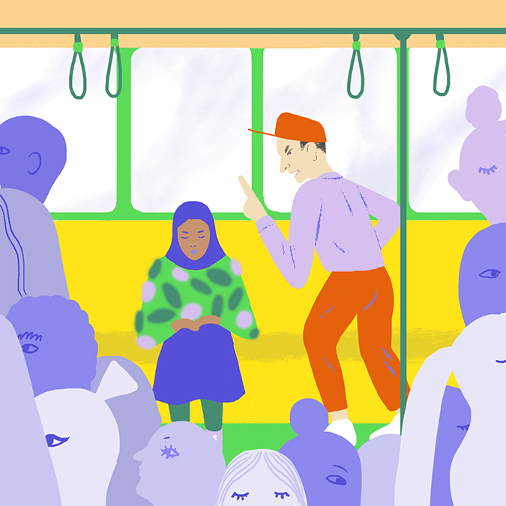
The Bystander Effect
The presence of others discourages an individual from intervening in an emergency situation or when a person is in distress.
Observers are more likely to take action if there are few or no other witnesses.
Notes:
The bystander effect (or bystander apathy) occurs when the presence of others discourages an individual from intervening in an emergency situation or when a person is in distress.
When an emergency situation occurs, observers are more likely to take action if there are few or no other witnesses.
Being part of a crowd has the effect that no single person has to take responsibility for an action (or inaction).
People assume that someone else will intervene, they don’t know how to take action, or feel ‘it’s not my responsibility’, fear escalation, etc. and therefore delegate responsibility to others.

Slide 11
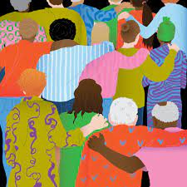
How to be an Active Bystander
Being aware of when someone’s behaviour is inappropriate or threatening (online or offline) and choosing to challenge it.
Before stepping in, assess for safety. Your personal safety is a priority.
Remember Hollaback!’s 5Ds to safe intervention: Distract, Delegate, Document, Delay & Direct.
Notes:
Many activist groups, like Hollaback!, see bystander intervention as a key form of activism for challenging sexual and gender-based violence and other forms of injustice like racisim. Hollaback! is an activist group that began in New York as a story-sharing blog to resist street harassment. It quickly expanded into a global movement which now tackles all forms of harassment including digital harassment. Hollaback!’s HeartMob platform seeks to help online victim-survivors of digital harassment and abuse.
Hollaback! has been developing tools since 2012 to help people intervene when they witness street harassment. Street harassment and gender discrimination are huge societal issues that need to be addressed and we all have a responsibility to do something about them, but too often we freeze because we don’t know what to do. Hollaback! has trained 32,600 people in bystander intervention using their 5Ds to safe intervention: Distract, Delegate, Document, Delay and Direct.
Being an active bystander means being aware of when someone’s behaviour is inappropriate or threatening (online or offline) and choosing to challenge it. If you do not feel comfortable doing this directly, then get someone to help you such as a friend or someone in authority.
Research shows that bystander intervention can be an effective way of stopping sexual assault before it happens, as bystanders play a key role in preventing, discouraging, and/or intervening when an act of violence has the potential to occur.
Before stepping in, assess for safety. Remember, your personal safety is a priority – never put yourself at risk. It’s safer to call out behaviour or intervene in a group. If this is not an option, report it to others who can act.
How you can intervene safely online and offline: remember Hollaback!’s 5Ds to safe intervention – Distract, Delegate, Document, Delay and Direct.

Slide 12
How to be an Active Bystander - the 5Ds
1. Distract - Interrupt, start a conversation with the person who is being targeted.
2. Delegate - Seek an authority figure, like a teacher to intervene.
3. Document - Record the interaction or take a photo.
4. Delay - Wait for the situation to pass and then ask the person if they’re OK or report it later.
5. Direct Action - Confront the situation by calling out negative behaviour. This tactic can be risky, assess the situation first.
Notes:
1. Distract - The aim here is simply to derail the incident by interrupting it. The idea is to ignore the harasser and engage directly with the person who is being targeted. Don’t talk about or refer to the harassment. Instead, talk about something completely unrelated. E.g., you could pretend to know the person being targeted and say they need to take a phone call or you need to speak to them, or you could ask them for directions or the time - any excuse to get them away safely.
2. Delegate - Ask for assistance, for a resource, or for help from a third party. Seek someone such as an authority figure, like a teacher to intervene in the situation.
3. Document - take screenshots/photos and screen recordings to provide a helpful testament to someone's experience if you suspect or detect that they are in harm's way. Make sure it is safe to do so. Afterwards, ask the person who experienced harm what they would like to do with the documentation. Never post or share a video without the consent of the person being harmed. Putting a video (or even a picture) online can expose the person who was harassed/abused and may also trigger the involvement of the police or institutional processes even when the person harmed doesn't want that.
4. Delay - if the situation is too dangerous to challenge, just walk away. Wait for the situation to pass and then ask the person who was harassed if they’re okay or report it later. It’s never too late to act.
5. Direct Action - Directly intervene by confronting the situation and calling out negative behaviour. Tell the person to stop or ask the victim-survivor if they’re OK. Be polite and stay calm, don’t aggravate the situation. This tactic can be risky: the harasser may redirect their abuse towards you and may escalate the situation. Before you decide to respond directly, assess the situation: Are you physically safe? Is the person being harassed physically safe? Does it seem unlikely that the situation will escalate? Can you tell if the person being harassed wants someone to speak up? Direct action is safer when you are in a group.

Slide 13
Scenario 1
What are some ways of being an active bystander in this scenario?
Remember the 5Ds and remember to prioritise your safety.
Tom yells ‘hey, nice boobs’ to Mia in the school corridor.
Notes:
Divide the class into groups of six and get them to discuss one scenario for five minutes (groups one and two: discuss scenario 1, groups three and four: scenario 2 and groups four and five: scenario 3). Ask them to think about how they would use the 5Ds to be an active bystander in these situations.
Ask the groups to report back to the class - maybe ask for two people from each group to act as spokespeople to ensure engagement.

Slide 14
Scenario 2
What are some ways that Nathan could be an active bystander in this scenario?
Nathan’s friends are sharing nudes of girls in a group chat. He feels uncomfortable with this, but doesn’t speak up because he is afraid they’ll call him ‘gay’.

Slide 15
Scenario 3
What are some ways of being an active bystander in this scenario?
Remember the 5Ds and remember to prioritise your safety.
A group of boys shout at Kezia ‘be ready for “slap ass Thursday” tomorrow.’

Slide 16
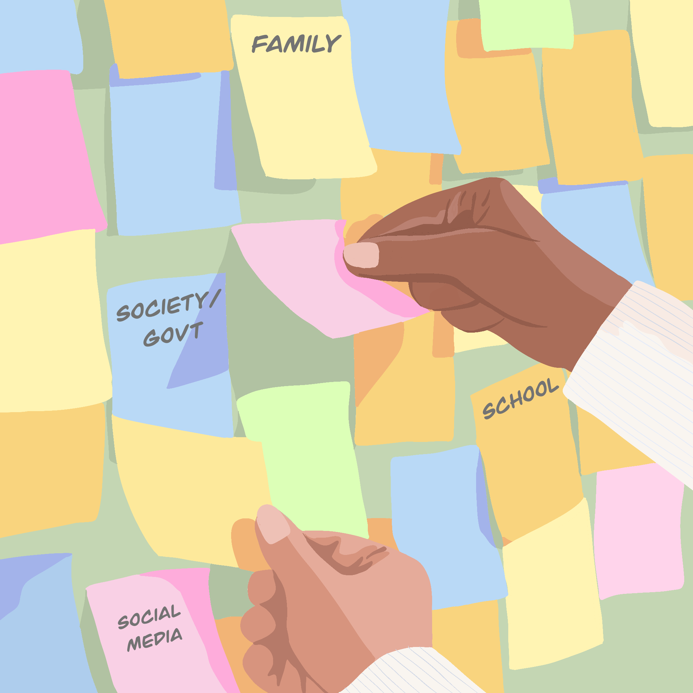
How can we Challenge Sexual and Gender-Based Violence through Activism?
What could you and your friends do to tackle sexual and gender-based violence?
What could your family do?
What could your school do?
What could social media platforms do?
What could society/ government do?
Notes:
Post it note exercise: in small groups, ask students to suggest things that these different spheres of influence could change.
To maintain engagement, delegate students from each group specific tasks, e.g., each student gathers post-its for a specific category and sticks them on the wall according to the nominated category (you and your friends, family, school, social media platforms, society/government).
Briefly feedback on common themes collected on post-its.
Discussion points:
Be sure to raise things like being an ally – you don’t have to experience sexual and gender-based violence to be an ally – to listen to someone’s experience, take them seriously. Tie into being an active bystander.
You can also harness digital tools to start campaigns like Everyone’s Invited and #MeToo.

Slide 17
How we can Challenge Sexual and Gender-Based Violence
Tell harassers that their behaviour is unwanted and unacceptable (but prioritise your own safety).
Be an active bystander: intervene safely using Hollaback!’s 5Ds: distract, delegate, document, delay & direct (first assess for safety).
Don’t share nudes of people without their consent and if someone tries to show you a nude of someone else, tell them it’s not OK.
Don’t support bait-out sites: don’t visit them or interact with them. Instead, report them.
Don’t victim blame victim-survivors of sexual and gender-based violence (e.g. people whose nudes have been shared), and challenge victim-blaming messaging by busting myths around sexual and gender-based violence.
Believe and support victim-survivors of sexual and gender-based violence and tell them that it’s not their fault.
Notes:
Focus on students’ experiences but use this slide as a prompt.
This slide will be provided as a handout.

Slide 18
Sharing Stories Online
Sharing stories is important for raising awareness of sexual and gender-based violence and for creating change.
Notes:
Everyone’s Invited, like many other campaigns against sexual and gender-based violence, typically began with young women and girls sharing their experiences of sexual and gender-based violence online, e.g., street harassment and sexual assault.
These online platforms are often seen as safe spaces for victims/survivors to share their stories because they can do so anonymously in ways they often cannot do offline, and get support from those that may have faced similar experiences.
Sharing stories is important for raising awareness of sexual and gender-based violence and for creating policy and cultural change.
Anyone with access to digital technologies can share their story online and/or provide solidarity to victims/surviors of sexual and gender-based violence.

Slide 19
Digital Defence Strategies
Stay safe online with these simple digital defence strategies:
Blocking: The user won’t exist virtually anymore.
Muting: The person’s posts and stories will no longer appear in your feed. Could be useful if a peer/Instagram follower.
Reporting: Report users or unwanted comments/images to a platform and/or to school, police, etc.
Having multiple accounts: Have a personal account using your name (e.g. on Snapchat) and a separate, anonymous account (e.g. Twitter) to talk about a particular/sensitive issue.
Online privacy: Understand how to use privacy settings on social media platforms and be able to identify fake profiles.
Notes:
Note: this slide will be provided as a handout.
Blocking: If you’ve received unwanted content on social media, you should do the same thing. Blocking a user means they virtually do not exist anymore. Don’t be ashamed or afraid to do this at any point - remember to put your well-being first.
Muting: The person’s posts and stories will no longer show up in your feed, but they'll still be able to see your posts, and you can visit each other's account pages. Could be useful if a peer/Instagram follower.
Reporting: Report users or particular comments/images to the platform in question and/or to school, police, etc. Each platform has a different reporting processes in place and all of these can be found by googling ‘Snapchat report abuse’, Instagram report abuse’, Twitter report abuse’, etc.
Having multiple accounts: Have a personal account with your name attached (e.g. on Snapchat) and a separate Twitter account to talk about activism or a particular issue (potentially anonymous).
Anonymity: Often used to speak about issues where people fear they would be judged harshly or feel incapable of talking about offline.
Online privacy: Includes understanding how to use privacy settings on social media platforms and being able to identify fake profiles.

Slide 20
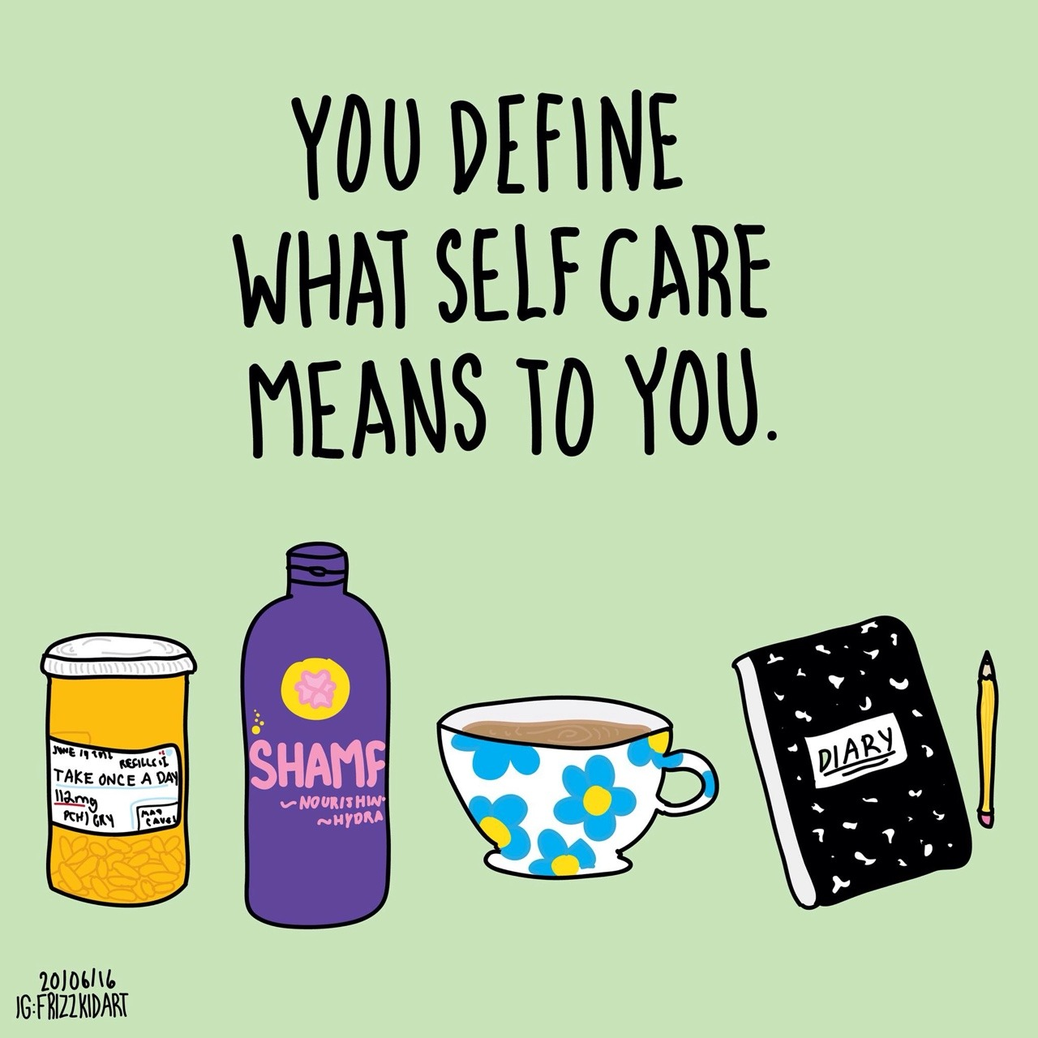
Self Care Strategies
Take time to look after yourself: do things that make you feel content.
Curate your social media pages/feeds.
Be mindful of which sites make you happy and stressed.
Take regular breaks from social media and screen time.
Notes:
Take time to look after yourself: do things that make you feel content, for instance, seeing friends, listening to music, having a bath, making use of mindfulness apps like Headspace.
Curate your social media pages/feeds. Curating your feed is being mindful and deliberate about the content you’re consuming, e.g., being intentional about the people, groups, and pages you follow; unfollowing people who post things that make you anxious or sad; and following people who post things that make you feel good.
Similarly, be mindful of which sites make you happy and stressed.
Take regular breaks from social media and screen time.

Slide 21
Some places you can go to talk things through
Rape Crisis - support for girls aged 13+ who have survived ANY type of sexual & gender-based violence (including online): rapecrisis.org.uk
Galop - support for LGBTQ+ people surviving abuse aged 13+: galop.org.uk
Imkaan - specialist BAME ending violence against women & girls agencies: imkaan.org.uk/get-help
Childline - support for U18s on any issue: childline.org.uk
Stop Street Harassment - help, advice and resources for tackling street harassment: stopstreetharassment.org
Remember you can also:
Block and report harmful/unwanted content
Survivors UK - support for men, boys and non-binary survivors of sexual & gender-based violence aged 13+: survivorsuk.org
Respond - support for survivors of sexual & gender-based violence with a learning disability aged 13 +: respond.org.uk
The Mix - support for U25s on any issue: themix.org.uk
Everyone’s Invited - a safe space for survivors of sexual & gender-based violence to share their story: everyonesinvited.uk
Everyday Sexism Project - a space to share stories of sexual harassment, abuse & other forms of everyday sexism: everydaysexism.com
Talk to parents, friends and trusted adults.
Notes:
This slide will be provided as a handout.
Explain that someone might also want to report to the police (they don’t have to if they don’t want to) - and they can get extra support with this from the first four organisations on this list with either deciding whether they want to report or not, or help navigating the criminal justice system.
For some forms of sexual and gender-based violence, like street harassment, there are currently no formal reporting systems or organisations that people can report to, but they can share their stories of street harassment and sexual assault, and get solidarity from other victims/survivors via websites like Everyone’s Invivted, Stop Street Harassment and the Everyday Sexism Project. These offer safe spaces for victims/survivors to share their stories anonymously and they provide information, advice, help and resources on sexual and gender-based violence.
Explain that students can also block and report harmful and/or unwanted content on social media platforms and that they can talk to their parents, friends and trusted adults.

Slide 22
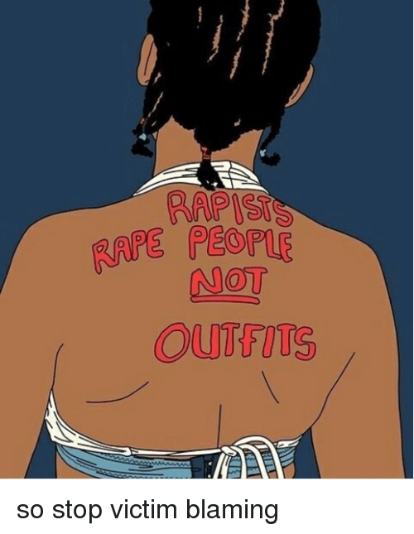
Activism and Art
Activists often use art and writing to create work which empowers those who are oppressed or marginalsed. Write down or create a hashtag / meme that tackles the issue of sexual and gender-based violence:
Notes:
Important: ensure there is sufficient time to run this activity.
5-10 minute activity: Divide students into small groups of 3 and ask them to provide examples of activist art, memes, hashtags etc. they are aware of and/or give them a mobile phone template and ask them to create a meme or hashtag to tackle the issue of sexual and gender-based violence, e.g., to make the issue visible, to challenge common misconceptions of sexual sexual and gender-based violence, or to foster solidarity and community-building among victims/survivors.
Get them to think about what makes an effective hashtag campaign, e.g., using clear, concise and easy to understand messaging, combining no more than 3-4 words.
When observing groups, ask how they found out about any examples of accounts, hashtags, influencers etc. they note down.

Slide 23
Survey
Thank you for participating in our workshop!
Please fill out the quick feedback survey.
Notes:
Important:
Ensure there is sufficient time at the end of the session for students to complete the survey and ask students to answer all the questions.
Link to survey: https://docs.google.com/document/d/1zpBaySbwhy_GYJokSJxGtGiI5cOUa3ua/edit?rtpof=true

